Slide 1


(EDA) - Hotel Booking Dataset
Yousef Mahmoud Ali
ML_Group2

Slide 2
Dataset Overview
Total Records: 36285
Booking Status
Lead Time
Type of Meal
Average Price
Date of Reservation
Special Requests

Slide 3
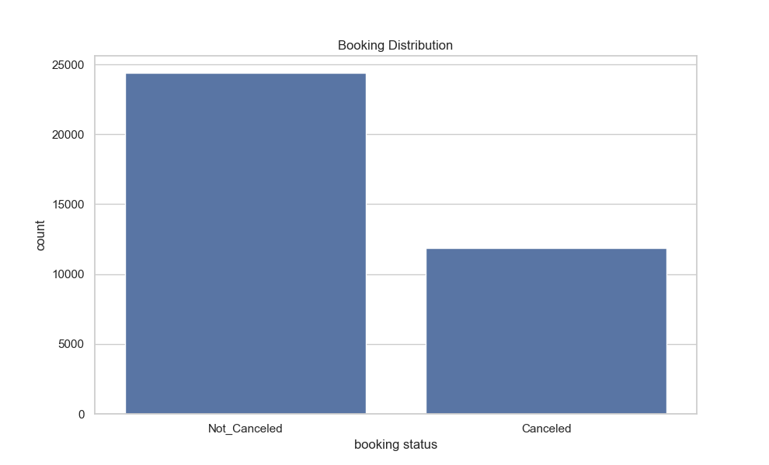
Booking Status Distribution
69% bookings kept; 30% canceled.
While cancellations exist, it is a positive sign.

Slide 4
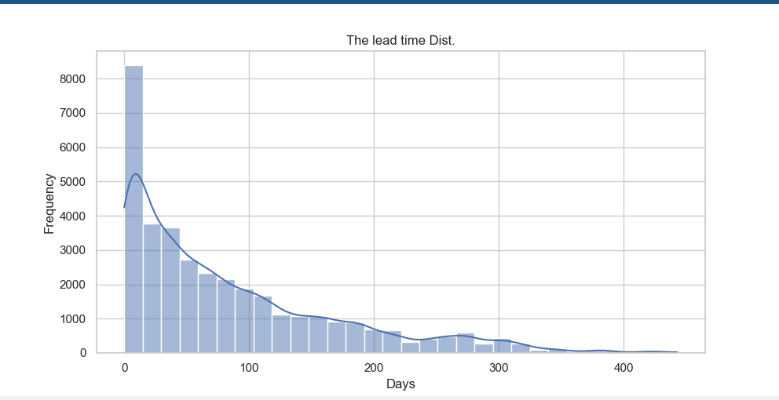
Lead Time Distribution
Most of guests book on short time
last-minute booking

Slide 5
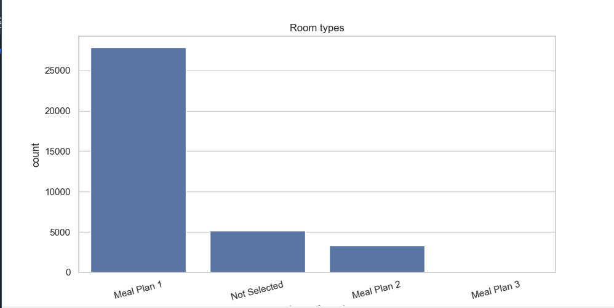
Type of Meal Distribution
Meal Plan 1 is the dominator
Guests preference

Slide 6
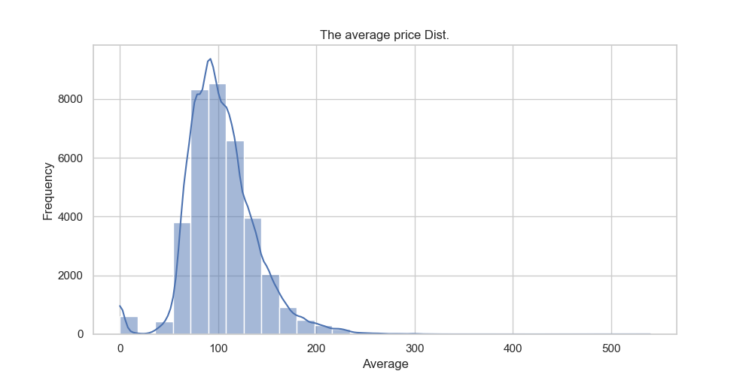
Average Price Distribution
Most Bookings are around ~75 to ~150 Few exceeds 150.

Slide 7
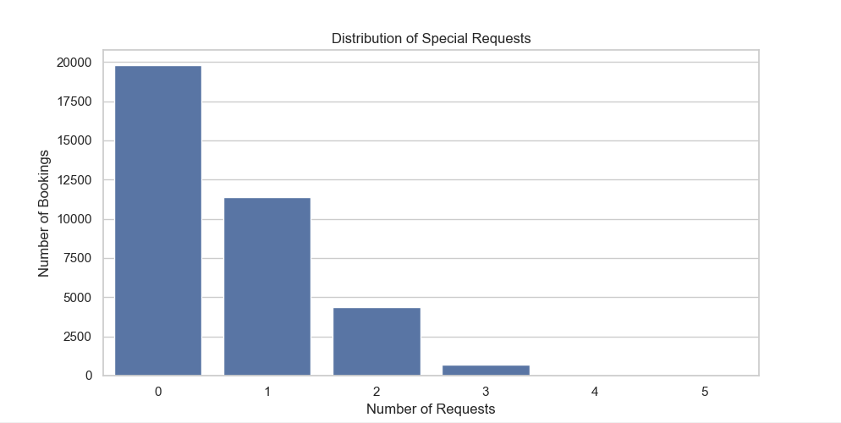
Special Requests Distribution
Over 80% of bookings have 0-1 requests
Requests drop sharply beyond 2, indicating complex needs.

Slide 8
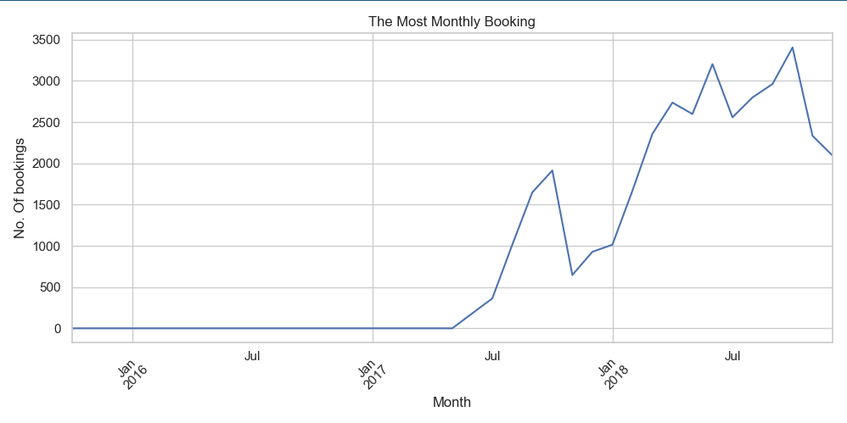
Monthly Booking Trends
Months like July and August have highest booking counts
Seasonality pattern.

Slide 9
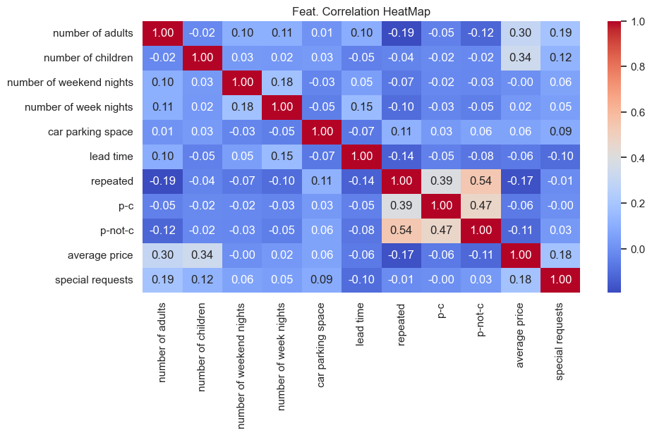
Feature Correlation Heatmap
Some relationships exist:
Repeat Guests ↔ Fewer Cancels
Longer Lead Time → Fewer Requests
P_C ↔ Special Requests

Slide 10

Thank You
Questions?

